Slide 1
RESTful
Pajamas
A hackathon project by: Shweta Parihar, Sri Chaitanya
Patluri, Luke McDuff and Benjamin Chrysler

Slide 2

Why RESTful Pajamas?
Do you ever feel like responding to the cry of your baby is too late?
Do you ever feel like you have to be tied to a baby monitor just to make sure your baby is sleeping?
Maybe you just want to check in on your baby and don't want to enter the room.
With RESTful Pajamas, just strap a sensor on your baby and we'll keep you updated!

Slide 3
The Pocket Baby Monitor
RESTful Pajamas offers a unique method of monitoring your little one.
With a normal baby monitor, you are able to hear the baby cry, but RESTful Pajamas will know when your child starts moving.
This gives you the opportunity to have those precious moments before they would normally start crying.
Our application offers the ability to check up on your baby by a simple interface that tells you whether your baby is sleeping or awake.
An active listener
The RESTful Pajamas embedded with sensor are always at work, sensing your babies movements.
By using a gyroscope sensor, we can determine the slight movements of your child while it is still in your crib.
The sensor is collecting a continuous stream of data that is being monitored by our system.
As soon as our algorithm decides that the baby is awake it notifies the user on the web page or android application.

Slide 4
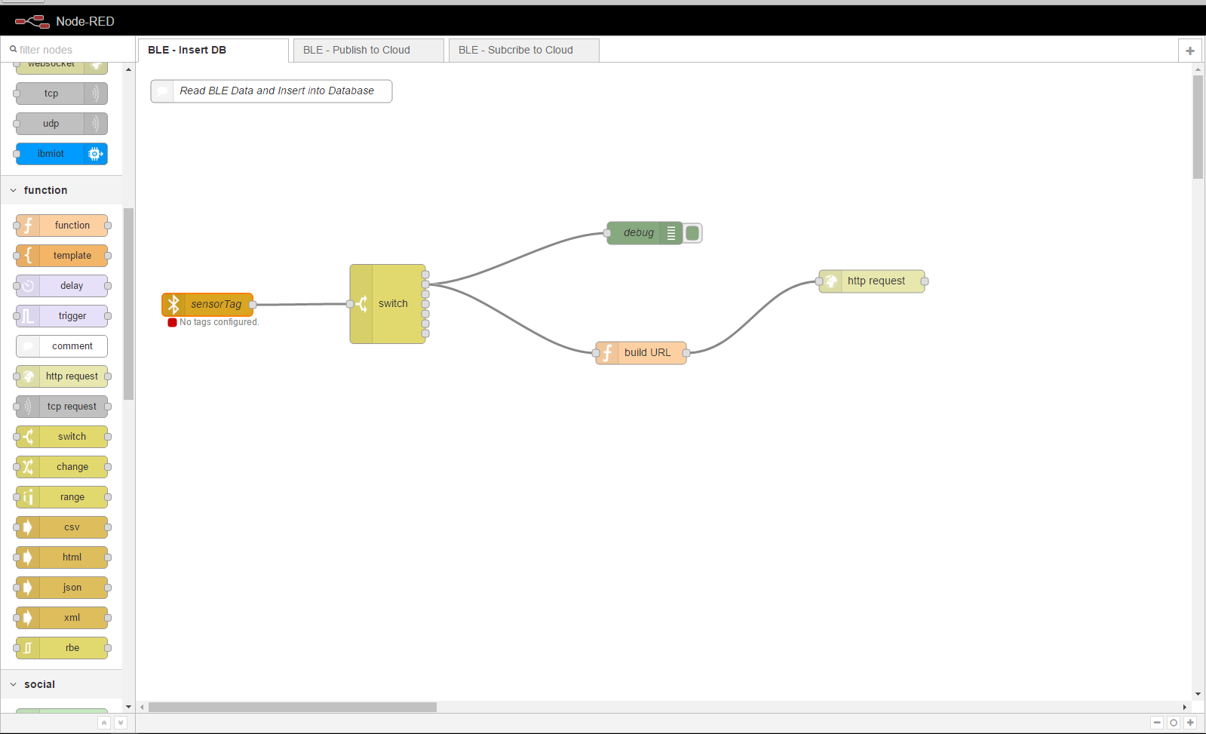
Node-RED Diagram

Slide 5
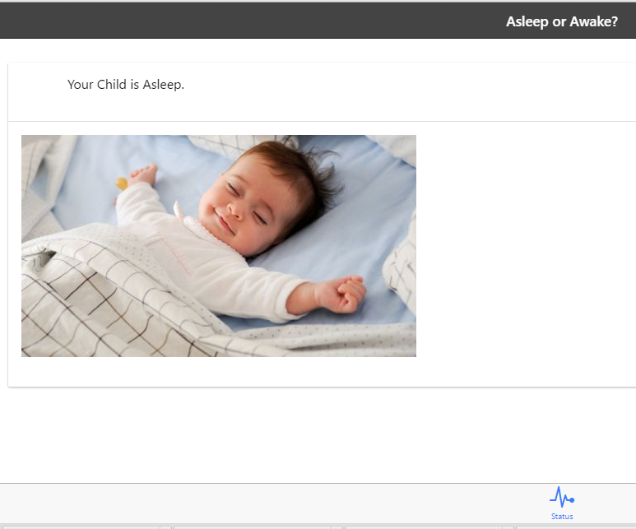


A Peep into the application
RESTful Pajamas web page Web page
RESTful Pajamas Android Application

